Slide 1
Welcome to Back to School Night
Bienvenido a la noche de regreso a la escuela
September 23, 2020
23 de septiembre de 2020
Notes:
**Read notes from bottom of the page on each slide...

Slide 2


Mrs. Vicente
Teacher Information Información de la maestra
Math Teacher(3 Blocks of 90 minutes)
Profesora de matemáticas (3 clases de 90 minutos)
21 years teaching experience 5 years at Perth Amboy HS and 16 years at Samuel E. Shull School
21 años de experiencia docente 5 en la HS y 16 en la escuela Samuel E. Shull
Contact Information Información del contacto
Email: marivicente@paps.net
Remind code: @shullg
Google Classroom: Ask your child to show you around! Pídale a su hijo que le muestre los alrededores
Notes:
-21 years experience - very comfortable with curriculum, still adjusting to virtual and digitizing resources
Contact information -
-Best way to contact is by email
-sign up for REMIND by entering code if you’d like to reach me by text
-Google Classroom - If you’ve provided me with an email address, I’ve added you to GC as guardian. This will send you a snapshot of the assignments your child has been assigned throughout the week. It does not show you your child’s work → Ask your child to show you his or her assignments to stay up to date with what he or she is completing.

Slide 3
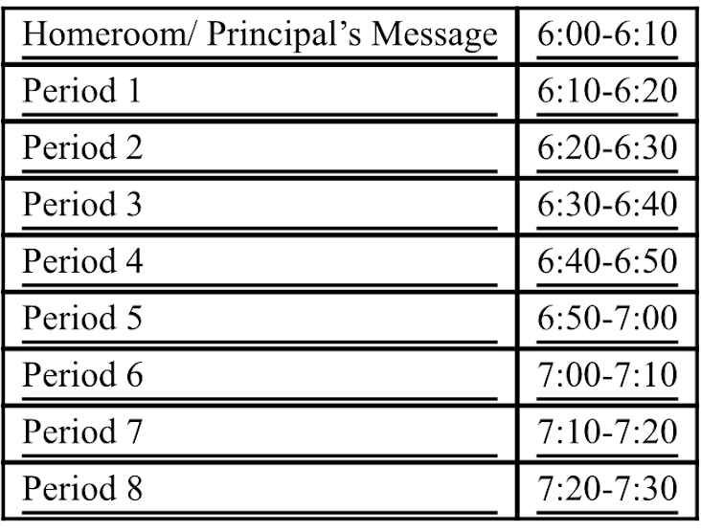
Tonight’s Schedule
For period 1, attend your child’s
A DAY exploratory class
Your child should help you travel from Google Meet to Google Meet as they do during a typical day 😊
During period 6 LUNCH, you may meet with school counselors or Child Study Team Members. More information to follow.

Slide 4

What does a typical day look like?
¿Cómo es un día típico?
Homeroom 8:01-8:22
Period 1 - Electives 8:22-9:09
Period 2/3 MATH block 9:09-10:43
Period 4 SS or Science 10:43-11:30
Period 5 ESL 11:30-12:17
Period 6 LUNCH 12:17-1:04
Period 7/8 ELA 1:04-2:33
Notes:
Homeroom is time to get prepared for the day, chat with classmates
During lunch, students log off of Google Meets, cameras are turned off
Charge computers during lunch

Slide 5

Shull School Mathematics!!
Welcome to 5th grade!

Slide 6
Here are some math topics we learn in 5th grade
Decimals
Reading, writing and modeling
Adding and subtracting
Multiplying and dividing
Fractions
Reading, writing and modeling
Adding and subtracting
Multiplying and dividing
Geometry
Operations and Algebraic Thinking
Measurement and Data
Main Focus of 5th Grade

Slide 7

What does a math class look like in 5th grade?
90-minute math block every day
-5 minute warm up
15 minutes modeling (teacher instruction)
10 minute small group work
Formative assessment to determine math centers

Slide 8
ALEKS
Computer program that can be accessed from any computer
Tailored to each child’s specific needs
Can serve as extra help for topics learned in class
Can serve as a challenge as well
STAR
Online assessment given 3 times a year
Helps determine students who need extra support in math or language arts
PARCC Connections

Slide 9

Assessments Evaluaciones
District Assessments evaluaciones del distrito:
STAR Reading & Math
Benchmark Assessments
Classroom Assessments evaluaciones del aula:
Weekly Self-Assessment on Fridays autoevaluación semanal
Quizzes based on learned materials → Math Reasoning & Computational skills, math vocabulary
Pruebas basados ​​en materiales aprendidos → razonamiento matemático y habilidades computacionales, vocabulario matemático
Math test/ assessments to assess learning after lessons, chapters, or units.
Evaluaciones de matemáticas para evaluar el aprendizaje después de lecciones, capítulos o unidades.
Traducido a través de Google Translate.
Notes:
STAR is an adaptive test, which means that the questions change based on how the student is doing. It assess reading and math skills and the better the student does, the harder the questions get. This helps us determine an approximate grade level equivalency for a students performance.
Writing assessments help us to see how students perform on a writing task before learning material, and how much they grow after we teach the units.
Benchmark Assessments are given 3 times a year to assess learning across the district.

Slide 10








Websites Sitios Web
Google Meet → Where we “meet” as a class daily
Donde nos "reunimos" como clase a diario.
Google Classroom → Where all assignments and announcements are posted each day. Google Meet link can also be found here.
Donde se publican todas las asignaciones y anuncios todos los días. El enlace de Google Meet también se puede encontrar aquí.
Google Drive → Programs students will use to complete assignments.
Algunos programas que los estudiantes usarán para completar las tareas.
  Google Docs
  Google Slides
  Google Forms
BrainPOP → Online videos that help students learn various materials.
Videos en línea que ayudan a los estudiantes a aprender varios materiales.
Traducido a través de Google Translate.
Notes:
- Discuss websites and how they will be used in class
- We have spent time reviewing how to use the first 3 sets
- BrainPOP will be shown from teachers computer

Slide 11



Websites (continued) Sitios Web (continuado)
Kahoot → An interactive quiz game to test what we’ve learned.
Un juego de preguntas interactivo para probar lo que hemos aprendido.
Learning Ally → An online bookshelf where we can find novels and independent reading materials.
Una estantería online donde podemos encontrar novelas y materiales de lectura independientes.
Nearpod → An online teaching and learning resource that covers various materials through interactive lessons.
Un recurso de enseñanza y aprendizaje en línea que cubre varios materiales a través de lecciones interactivas.
Traducido a través de Google Translate.
Notes:
- The kids are loving Flipgrid for the most part so I hope to incorporate as much as possible
- Kahoot is a great way to practice vocabulary and test our knowledge in a friendly competition
- Learning Ally → Super important for the kids to be able to access as our novel for the 1st marking period is available there. School issued chromebooks have an app installed on the bottom of the computer .. Personal computers and devices will need to download an app -- it’s free. It’s imperative that you help your child get this installed on your computer or another device that he or she has access to during school hours. It’s available in the Google Play store and Apple App store
- Nearpod → I personally have yet to use this with students this year, but it will be incorporated into our lessons in time. Great student-paced lessons to teach various topics and complete assignments directly on the slides provided

Slide 12

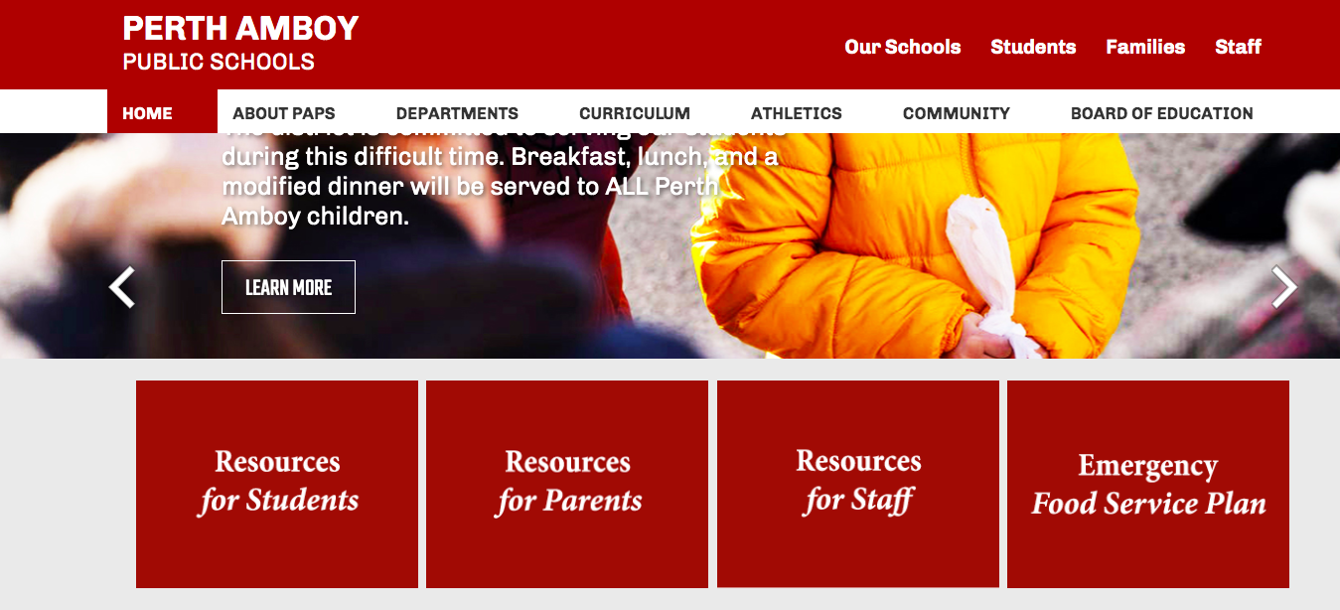
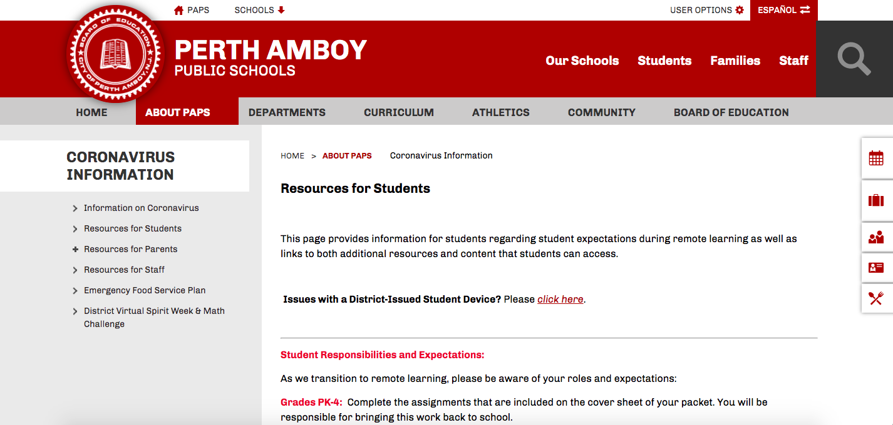
Computers/WiFi Computadoras/WiFi
If you are in need of a device, let me know ASAP.
Si necesitas una computadora, avisame lo antes posible
If you have an issue with a device, visit www.paps.net
Si tiene algún problema con un dispositivo, visite www.paps.net
Traducido a través de Google Translate.
Notes:
If you need a device, email me. I’ll forward your information to our principal, Ms. Espana. Next shipment is due in October so there may be a brief waiting period for a Chromebook.
If you are having issues with a device you’ve been provided, visit www.paps.net → Click RESOURCES FOR STUDENTS → Click where it says CLICK HERE and submit the issues you are having

Slide 13

Class Rules/Expectations Reglas / expectativas de la clase
Traducido a través de Google Translate.
Notes:
-Please be mindful of your childs location in the home and the background
-Have a charger handy so kids can charge if needed during the day while they are working
-Cameras MUST be on - district policy
-Technology issues will arise - please let us know of anything that is interfering with your child’s ability to be in class and follow these rules. While we will be mindful and flexible as you work through any issues, it is the expectation that issues that arise will be resolved in a timely manner so as not to interfere with your child’s ability to join us for class meetings, complete graded assignments, and participate appropriately.

Slide 14

Class Rules/Expectations Reglas / expectativas de la clase
Traducido a través de Google Translate.
Notes:
-Bathroom / stretch / water / snack breaks will be given during the morning as it is a long stretch of time to be in class
-A typical break, for now, is 10 minutes, and I have been giving 2 each morning. It is the expectation that students return from breaks promptly when the timer goes off at the end of the break.

Slide 15


Assignments & Late Work
Asignaciones y trabajo atrasado
Assignments are expected to be completed during class time.
Se espera que las asignaciones se completen durante el tiempo de clase.
If students are unable to finish assignments during class, they should be completed by the end of the day in order to be considered on time, unless otherwise noted by the teacher.
Si los estudiantes no pueden terminar las tareas durante la clase, deben completarlas al final del día para que se les considere a tiempo, a menos que el maestro indique lo contrario.
On Fridays, there will typically be time for students to assess their progress throughout the week and ensure that there are no missing assignments.
Los viernes, normalmente habrá tiempo para que los estudiantes evalúen su progreso durante la semana y se aseguren de que no falten tareas.
Traducido a través de Google Translate.
Notes:
First point → I am assigning work based on skills and after 10 years of experience, I can anticipate fairly well how long an activity should take. The work assigned is designed to be able to be completed within the class period.
Third point → I am trying to give everyone a chance to make up any assignments we may have fallen behind on or have overlooked. During this time, assignments completed late will be marked accordingly. My goal is for students to start each week fresh without any lingering assignments that are missing. Students who have finished will have an opportunity to demonstrate what they’ve learned throughout the week in Flipgrid.

Slide 16

Student Absences
Ausencias de estudiantes
Attendance is taken daily during each period
La asistencia se toma diariamente en cada período
Students not present in the Google Meet for the majority of class will be marked as absent
Los estudiantes que no estén presentes en Google Meet durante la mayor parte de la clase se marcarán como ausentes
If you have a doctor’s note, please email it to me. I will forward it to the school nurse.
Si tiene una nota del médico, envíemela por correo electrónico. Se lo enviaré a la enfermera de la escuela.
Students will have two days to complete missed work. After 2 days, assignments will be marked as late and points will be taken off.
Los estudiantes tendrán dos días para completar el trabajo perdido. Después de 2 días, las tareas se marcarán como tardías y se quitarán los puntos.
Traducido a través de Google Translate.
Notes:
2 days after the absence to complete work, at which point it will begin to lose points for being turned in late.

Slide 17
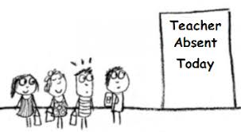

Teacher Absences
Ausencias de maestras
Another teacher will fill in using the same Google Meet link.
Otro profesor completará con el mismo enlace de Google Meet.
Assignments will be posted in Google Classroom to complete for the day
Las tareas se publicarán en Google Classroom para completar durante el día.
Traducido a través de Google Translate.
Notes:
No substitute teachers → Other staff members filling in throughout the day for one another
Please be patient for the link to open as staff members will be coming straight from concluding another class
Assignments will be posted in Google Classroom for that class

Slide 18

Infinite Campus
Sign up for Parent Portal if you haven’t already done so.
Regístrese en el Portal para padres si aún no lo ha hecho.
The link can be found on the Resources for Parents page on www.paps.net/shull
El enlace se puede encontrar en la página de Recursos para padres en www.paps.net/shull
Infinite Campus allows you to Infinite Campus les permite
See your child’s current grades Ver las calificaciones actuales de su hijo
View your child’s progress reports when available
Ver los informes de progreso de su hijo cuando estén disponibles
View your child’s report cards when available
Ver las boletas de calificaciones de su hijo cuando estén disponibles
Check your child’s attendance records Verifique los registros de asistencia de su hijo
Traducido a través de Google Translate.
Notes:
No substitute teachers → Other staff members filling in throughout the day for one another
Please be patient for the link to open as staff members will be coming straight from concluding another class
Assignments will be posted in Google Classroom for that class

Slide 19

School Administrators & Counselors
Administradores y consejeros escolares
Principal:
Ms. Melissa Espana
mespana@paps.net
Vice Principals Subdirectores:
Mr. Gregory Sneed
gsneed@paps.net
Ms. Robin Carrera
robycarrera@paps.net
Mr. Robert Dahill
robedahill@paps.net
School Counselor Consejera:
Ms. LaVerne Green
lavegreen@paps.net
Child Study Team Special Education
Dr. Kevin Lynn, Psychologist
Ms. Tamara Colangelo, Social Worker
Ms. Maribeth McCauliff, Social Worker
Ms. Kathryn Warlick, LDTC
Traducido a través de Google Translate.
Notes:
Contact Information for school administrators should you like to reach them for any reason is provided here. Our fifth grade school counselor is Ms. Green → If your child is in the general education program she can assist with any personal issues, scheduling conflicts, or general assistance. She can also meet with your child, upon request/appointment, to discuss any issues the child may be facing in or out of the classroom. Her contact information is above. I am also happy to put you in contact with her if you would like to speak with Ms. Green at any time. If your child is in the special education program, he or she has one of the above members from the CST as a case manager. If there are any concerns or issues regarding information in your childs IEP, please let us know and we can put you in contact with them. *INSERT INFORMATION ABOUT MEETING WITH COUNSELORS DURING BTS NIGHT HERE *

Slide 20

Breakfast/Lunch Available
Daily 10:30 - 1:00
The school buildings will be serving their population a nutritious, grab and go breakfast and lunch during that time. Students and parents have the option of going to any of the school sites closest to their home to pick up meals daily. Pick up sites will be set up in the main entrance of each school where all CDC Guidelines and social distancing protocols will be in place. ID cards will not be required at this time.
Los edificios escolares servirán a su población un desayuno y almuerzo nutritivo para llevar durante ese tiempo. Los estudiantes y los padres tienen la opción de ir a cualquiera de las escuelas más cercanas a su hogar para recoger las comidas todos los días. Los sitios de recogida se instalarán en la entrada principal de cada escuela, donde se implementarán todas las pautas de los CDC y los protocolos de distanciamiento social. No se requerirán tarjetas de identificación en este momento.
Notes:
10:30 am – 1:00 pm at all district schools, except for the Dual Language School in Fords, Perth Amboy Adult School and the 9th Grade East Campus. The following school buildings will be serving their population a nutritious, grab and go breakfast and lunch during that time. Students and parents have the option of going to any of the school sites closest to their home to pick up meals daily.

Slide 21


Mrs. Vicente’s Contact Information Información del contacto
Please make sure you have this information recorded for your reference.
Asegúrese de tener esta información registrada para su referencia.
Email: marivicente@paps.net
Telephone: (732)347-6496
Remind code: shullg
text @shullg to 81010 envía un mensaje de texto a @ shullg al 81010
Google Classroom: Ask your child to show you around!
Pídale a su hijo que le muestre los alrededores
Traducido a través de Google Translate.
Notes:
Instruct parents to join REMIND → Easy way to contact me, goes straight to my phone
This presentation will be available on my teacher website at www.paps.net/shull for future reference

Slide 22

Questions
What do you wonder?
¿Qué te preguntas?
How do you think 5th grade will be different than 4th grade?
¿En qué crees que se diferenciará el quinto grado del cuarto grado?
What are you excited about? Nervous about?
¿Qué te emociona? ¿Nervioso por?

